Slide 1

Introduction to Jenkins
Module 8: Jenkins Plugins

Slide 2
Topics
Core and recommended plugins
Code quality (SonarQube)
Security and dependency scanning
Cloud, Docker, and Kubernetes integrations

Slide 3
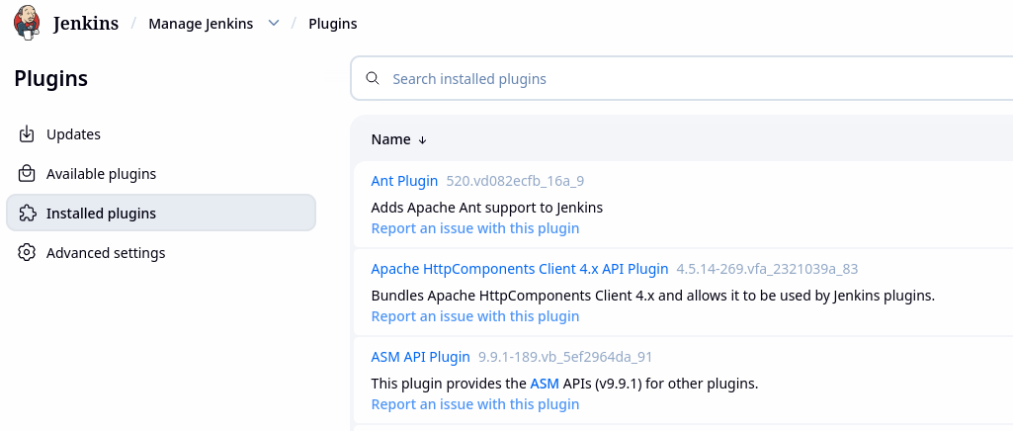
Jenkins Core vs Plugins
Jenkins is intentionally designed with
  A small, stable core
  Most functionality delivered through plugins
Examples of features provided by plugins
  SCM integration (Git, GitHub, GitLab)
  Pipelines and DSLs
  Credentials handling
  Cloud and container agents
  Code quality and security scanning
  UI extensions

Slide 4
Plugin Architecture
Plugins are written in Java
  Loaded into the Jenkins controller JVM
Extend Jenkins by providing
  New pipeline steps
  New job types
  New UI screens
  New APIs
Runtime behavior
  Plugins run inside Jenkins
  Share the same memory and process
  Have deep access to Jenkins internals

Slide 5
Plugin Lifecycle
Plugin lifecycle
  Add the plugin to the configuration
    Only done once
  Jenkins loads plugin at startup
  Plugin adds features
  Plugin is updated or removed as required
Some plugins require
  Jenkins restart
  Plugin dependency updates

Slide 6
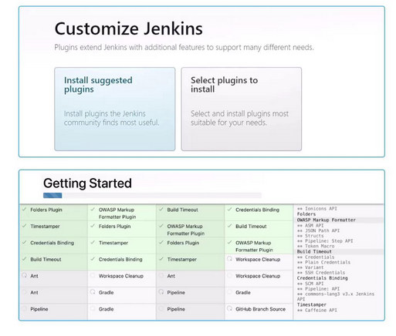
Plugin Update Management
If using Jenkins LTS as a production system
  Update plugins regularly, not randomly
  Test plugin updates in non-production Jenkins instances
  Update plugins in controlled batches
  Avoid auto-updating in production

Slide 7
Core and Recommended Plugins
Jenkins core provides basic functionality
Includes
  Job scheduling
  UI framework
  Security foundation
Core is intentionally minimal.

Slide 8
Core and Recommended Plugins
During initial setup, Jenkins offers “Suggested plugins”
  These typically include
    Pipeline
    Git
    Credentials
    Matrix authorization
    Workspace cleanup
Plugin best practices
  Install only what you need
  Remove unused plugins
  Prefer well-maintained plugins
  Check update activity and issue history

Slide 9
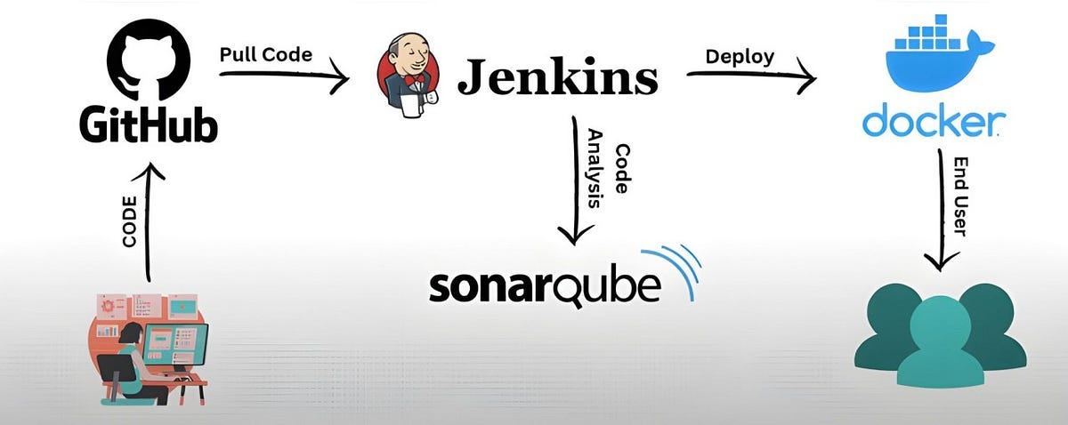
Code Quality Plugins (SonarQube)
The SonarQube plugin enables
  Static code analysis
  Code smell detection
  Coverage reporting
  Quality gates
Pipeline flow
  Build code
  Run tests
  Run Sonar analysis
  Evaluate quality gate
Image Credit: https://medium.com/@abubakr.sadiq/integrating-sonarqube-with-jenkins-pipeline-5bbfe3b46655

Slide 10
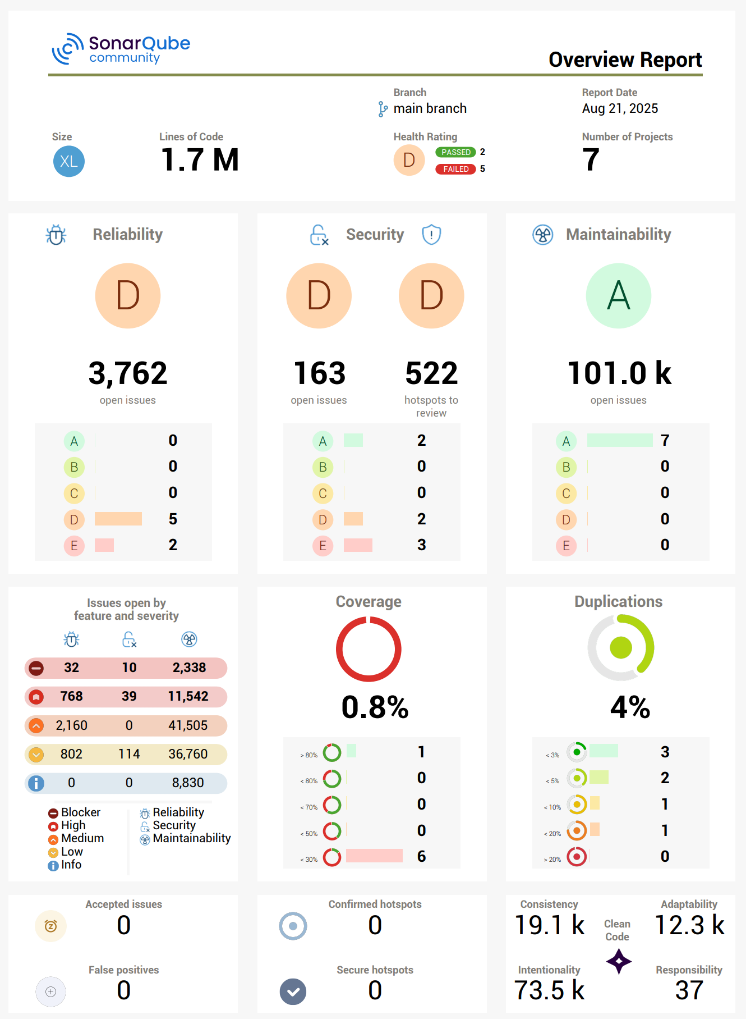
Code Quality Plugins (SonarQube)
Why SonarQube is popular
  Language-agnostic
  Enterprise-friendly
  Strong Jenkins integration
  Supports visual dashboards
Regular use of code scans support
  Maintaining code quality
  Reducing technical debt incurred by poorly structured code
  Enforcing standards and best practices
Image Credit: https://www.bitegarden.com/how-to-create-sonarqube-overview-mqr

Slide 11
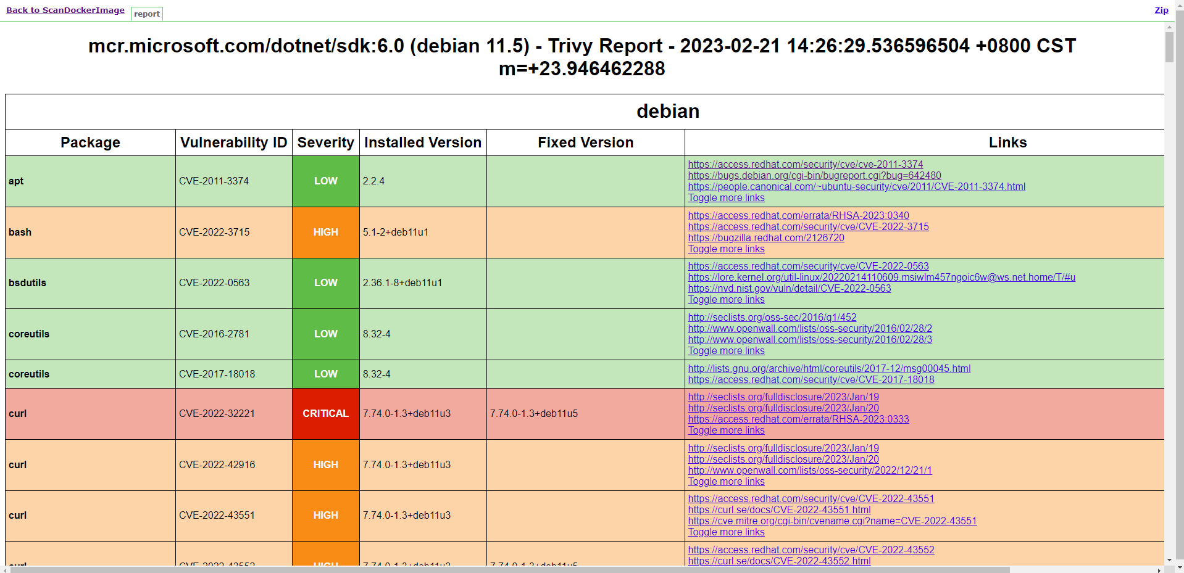
Security and Dependency Scanning
Modern CI pipelines:
  Shift security left
  Catch vulnerabilities early
  Automate compliance checks
Common security plugin types
  Dependency vulnerability scanning
  Container image scanning
  Secret detection
  License compliance checks
Examples:
  OWASP Dependency-Check
  Trivy
  Snyk
  Anchore
Image Credit: https://github.com/aquasecurity/trivy/issues/3660

Slide 12
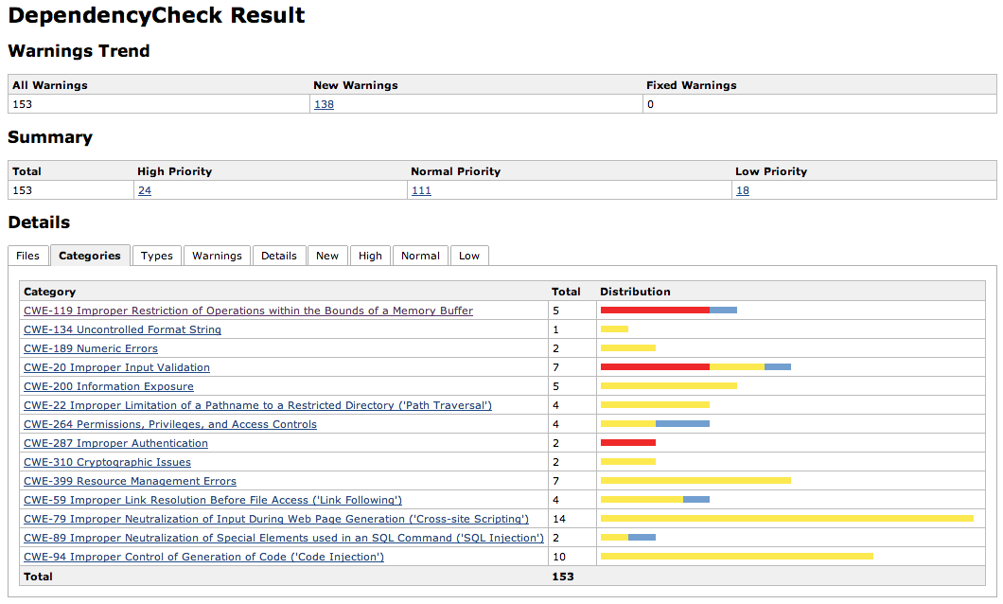
Security and Dependency Scanning
Security plugins
  Run as pipeline steps
  Produce reports
  Can fail builds automatically
Image Credit: https://wiki.jenkins.io/JENKINS/OWASP-Dependency-Check-Plugin.html

Slide 13
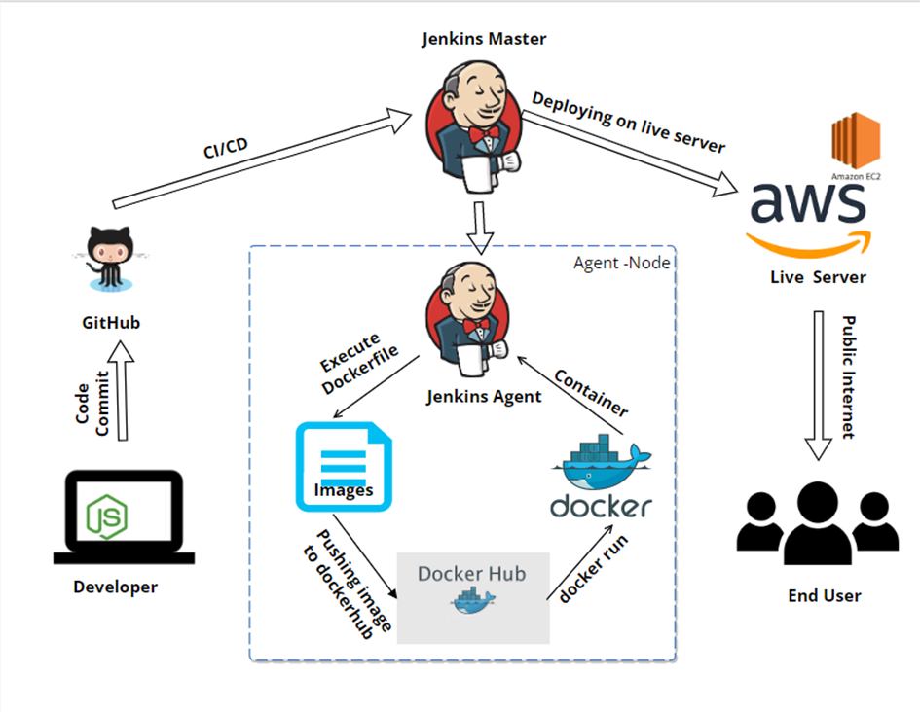
Cloud, Docker, and Kubernetes Integration
Early Jenkins setups
  Ran builds on the controller
  Used long-lived static agents
  Were hard to scale
  Had inconsistent environments
Modern Jenkins needs
  Isolation between builds
  Elastic scaling
  Clean environments per job
  Cost-efficient resource usage
    Jenkins controls builds, but agents execute them.
    Cloud and container integrations are ways to create agents dynamically.
Image Credit: https://asktheman.xyz/

Slide 14
Docker Integration
Docker integration means two things
  Docker as a build environment
    Jenkins agent runs inside a Docker container
    Each build gets a clean container
    Tools are preinstalled or injected
  Docker as a build target
    Pipeline builds Docker images
    Pushes them to registries
    Deploys containers
Image Credit: https://asktheman.xyz/

Slide 15
Common Docker Plugins and Capabilities
Docker-related plugins enable
  Docker-based agents
  Running steps inside containers
  Managing Docker credentials
  Interacting with Docker registries
Use cases
  Language-specific builds
  Legacy tool isolation
  Reproducible CI environments
Image Credit: https://asktheman.xyz/

Slide 16
Kubernetes Integration in Jenkins
Kubernetes solves problems Docker alone can’t
  Multi-node scheduling
  Auto-scaling
  Resource management
  High availability
Kubernetes can act as a dynamic agent factory
  Can scale up the number of Docker containers required in a pipeline
  Allows better load balancing across agents
  Allows agents to scale as needed
Image Credit: https://asktheman.xyz/

Slide 17
Kubernetes Integration in Jenkins
The Kubernetes plugin allows Jenkins to
  Define agent templates as pods
  Request pods on demand
  Run pipelines inside pods
  Destroy pods after completion
Pipeline flow
  Jenkins needs an agent
  Kubernetes creates a deployment to create pods that contain agents
  Pipeline runs
  Pod is deleted
Image Credit: https://asktheman.xyz/

Slide 18
Kubernetes Integration in Jenkins
Ephemeral pods
  Reduce attack surface
  Prevent state leakage
  Ensure clean environments
  Simplify scaling
Image Credit: https://asktheman.xyz/

Slide 19
Cloud Provider Integration in Jenkins
Cloud plugins allow Jenkins to
  Provision agents as VMs
  Integrate with cloud identity systems
  Use cloud-native storage and networking
Examples
  EC2 agents
  Managed Kubernetes clusters
  Cloud credential injection
Image Credit: https://asktheman.xyz/

Slide 20
Cloud-Based Jenkins Pattern
Jenkins controller runs
  On-prem
  In a VM
  In Kubernetes
Agents run
  On cloud VMs
  In Kubernetes pods
  As containers
This supports
  Hybrid environments
  Gradual cloud adoption
Image Credit: https://asktheman.xyz/

Slide 21
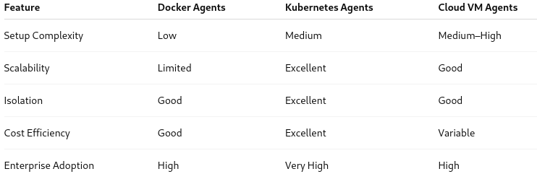
Comparison

Slide 22
Tool Config Revisited
With ephemeral agents
  Nothing is preinstalled
Tools must be provided in one of the following ways
  Auto-installation when the agent runs
  Prebaked into Docker images
  Provided via additional containers
This is why
  Global tool definitions matter
  Container images are curated
  Shared libraries become important
Image Credit: https://asktheman.xyz/

Slide 23
Global Tool Definitions
When Jenkins uses
  Docker agents
  Kubernetes pod agents
  Cloud-provisioned agents
Those agents
  Start empty
  Are destroyed after the build
  Do not remember previous builds
  So Jenkins cannot assume tools already exist
Image Credit: https://asktheman.xyz/

Slide 24
Global Tool Definitions
Global tools
  Define what tools a pipeline needs
  Provide consistent versions
Allow Jenkins agents to
  Install tools automatically
  Expose tools via PATH
  Make pipelines portable
Image Credit: https://asktheman.xyz/

Slide 25
Container Images Are Curated
Auto-installing tools on every build
  Slows pipelines
  Depends on external downloads
  Introduces variability from repeated installations, version drift for example
  Creates failure points
Curated solution
  Pre-build container images
  With:
    JDK
    Build tools
    OS packages
  These images become standardized build environments
Image Credit: https://asktheman.xyz/

Slide 26
Container Images Are Curated
A curated image is
  Built intentionally
  Versioned
  Reviewed
  Security-scanned
  Used consistently
Curated images are
  Subject to governance rules
  Part of the official Jenkins infrastructure in the organization
Image Credit: https://asktheman.xyz/

Slide 27
Shared Libraries
When pipelines are used with
  Many teams
  Many repos
  Many pipelines
  Ephemeral agents
Problems occur when
  Every pipeline is installing tools
  Every pipeline is reinventing logic
  Every team is solving the same problems over and over
Image Credit: https://asktheman.xyz/

Slide 28
Shared Libraries
Shared libraries
  Centralize logic
  Encapsulate complexity
  Standardize how tools and images are used
  Hide implementation details
The library
  Selects the right image
  Ensures tools exist
  Applies retries, logging, security
Image Credit: https://asktheman.xyz/

Slide 29
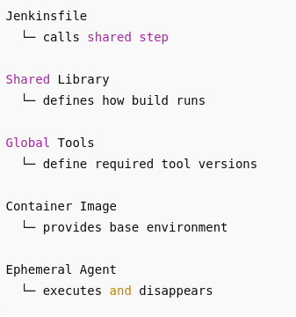
Modern Jenkins Flow
Pipeline starts
Jenkins provisions an ephemeral agent
Agent uses a curated container image
Global tool definitions standardize versions
Shared library executes trusted logic
Agent is destroyed

Slide 30
Modern Jenkins Flow
If these practices aren’t used
  Pipelines hardcode paths to tools
  Agents’ configurations drift over time
  Builds behave inconsistently
  Security issues multiply
  Jenkins becomes a snowflake again
Image Credit: https://asktheman.xyz/

Slide 31
Questions

